Slide 1

Useful stuff in 4 lines of code
Daniel Steinmeier – Digital Preservation Officer

Slide 2
Goal
Explore how many tweets are in a personal twitter archive without manual counting
Basic JSON parsing
Basic python knowledge required: lists, with-statement, importing libraries, print, variable assignment, data type conversion
Inspired by video “How to Search Your Twitter Archive with Python” by Ian Wootten: https://www.youtube.com/watch?v=1HXYb16BbsU

Slide 3
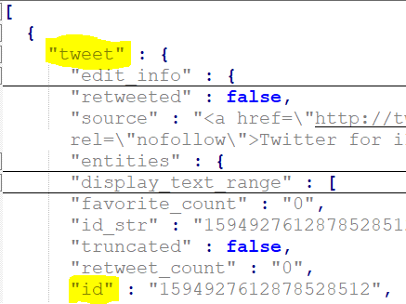
JSON
Javascript object notation
Used for storing content in twitter archive
Notation resembles data types in python like lists [] and dictionaries {}
Start of object
First level: tweet
Second level: other data types including id

Slide 4
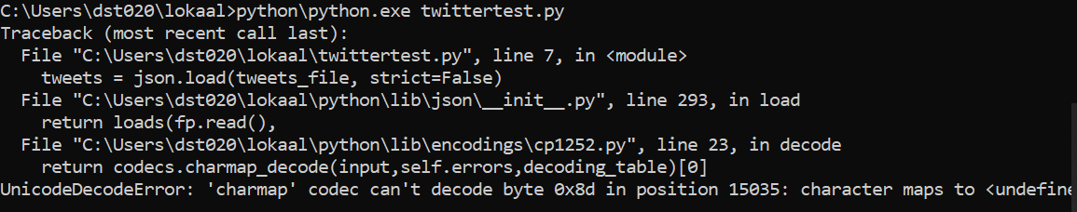
First problem: textencoding

Slide 5
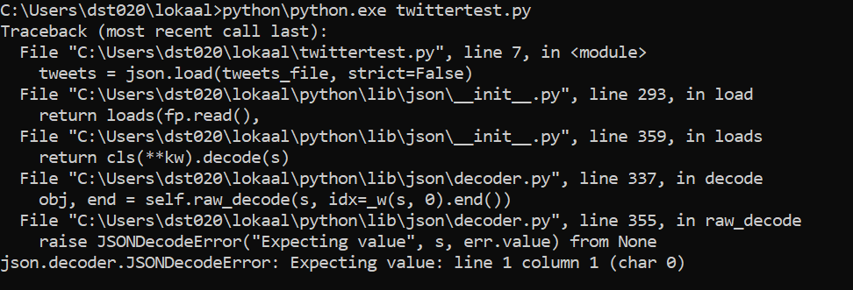
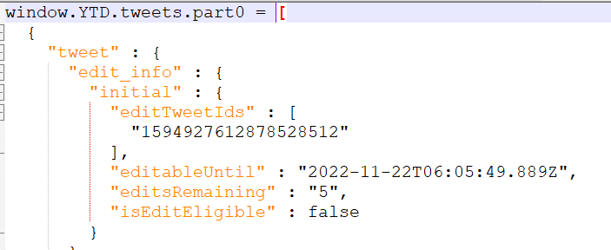
Second problem: invalid JSON

Slide 6
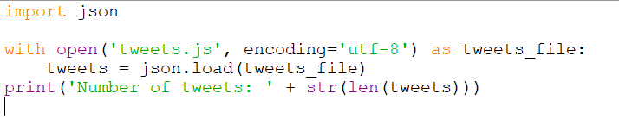

Number of tweets in 4 lines of code
Import standard json-library
Open tweets JSON file, mind text encoding
Load JSON file (assign to variable ‘tweets’)
Print the length of the list (how many items are in the list)
Notes:
import json
with open('tweets.js', encoding='utf-8') as tweets_file:
tweets = json.load(tweets_file)
print('Number of tweets: ' + str(len(tweets)))

Slide 7
Abstractions explained
Using a with-statement for automatic closing of file at the end
tweets_file is the variable that refers to the file handle returned by calling ‘open’
The open function takes as input the location/name of the file and optionally text encoding
tweets is the variable that stores the return value of calling ‘load’ on the file handle: tweets_file
json.load is the method from the library imported in line 1 taking care of parsing the JSON-file
It returns python data types created/parsed from javascript/json data types
The return value is a list (the whole object) that contains dictionaries (the separate tweets)
By printing the length of the list you basically count the number of list items
The list items correspond to dictionaries/tweets
The print function has a literal string: ‘Number of tweets: ‘
This string is concatenated ( ‘+’) with the number returned by calling ‘len’ (length)
The number is cast (converted) to string-type (by calling ‘str’) else concatenation is not possible
Read it inside-out:
‘tweets’ is input for a len-function which is input for a str-function which is (partial) input for the print-function

Slide 8
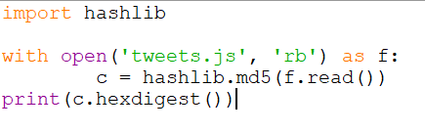
Calculate a checksum in 4 lines of code
Import hashlib standard library
Open tweets JSON file, file handle is assigned to f
Read the contents of f and provide as input to hashlib.md5
Print the output of c.hexdigest-method
Warning! Not efficient for very large files because it loads the whole file in memory..
8268bd226c1be52e65953d388d917206
>>>
Notes:
import hashlib
with open('tweets.js', 'rb') as f:
c = hashlib.md5(f.read())
print(c.hexdigest())

